Slide 1
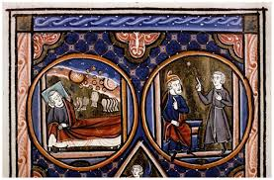

Dream Vision Tradition in the Middle Ages and Pearl
Assist. Prof. Dr. Pelin GÖLCÜK MİRZA

Slide 2
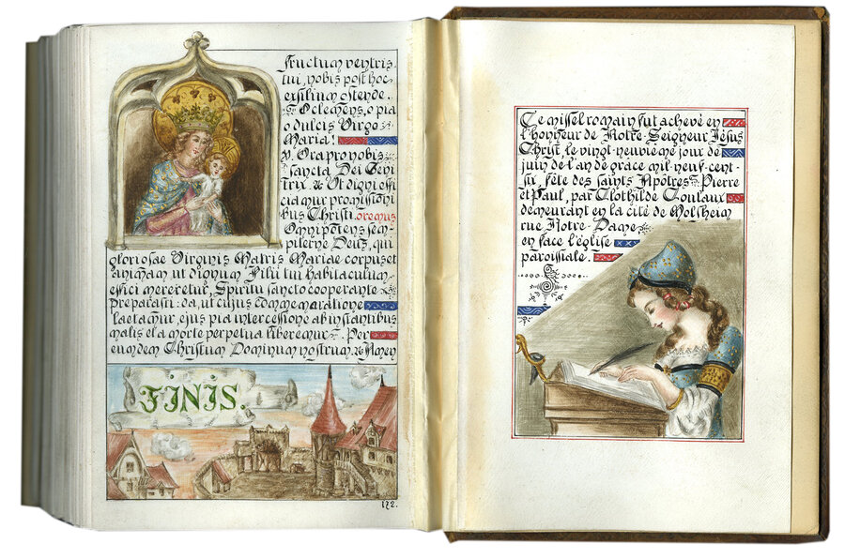
Dream vision is the best representative of the fusion of dreams and literature
It dates back to 12th century
This popularity is explained by A.C. Spearing as medieval people’s «orientation towards the ideal» or their temporary wish of flight from the «World of pain, labour, plague, and famine to a pleasenter realm of imagination» (p. 235)

Slide 3
*It reflects the aspirations of medieval folk for the better in their lives, who is sort of everyman, through the spiritual journey in dream visionary.
*Under the umbrella term of dream vision-or dream allegory- individual works show differences in accordance to their aim and structure. thus the broad definition given in Encyclopedia of Medieval Literature meets the various aspects of the genre:
  The dream vision was a favorite genre of medieval narrative poetry, in which a narrator falls asleep and dreams what becomes the main body of the story. Often the dream was in the form of an allegory*, or was otherwise enigmatic, and called for interpretation on the part of the reader. Dream visions might be serious moral or religious tracts (1) like Alanus de Insulis's Complaint of Nature (ca.1165), or might be comic or romantic secular (2) love poems like Chaucer's House Of Fare (ca. 1379), or allegorical political debates (3) Jike the 14th-century Middle English poem in alliterative verse Winner And Waster, of perhaps even satirical (4), like the third book of The Lamentations of Matheolous. (Ruud 192)

Slide 4
Macrobius’ categories
True dream types:
*Oraculum ( an authority reveals the truth, what action to take or to avoid)
*Visio
Somnium
False types:
insomnium
Visum
*They bring knowledge to human beings from the divine source

Slide 5
Structure: The important structure is about a perplexed narrator who is sleeping and dreaming, then his dream will be the main story. The dream often takes the structure of allegory and involves a type of understanding by the reader. The troubled narrator is stimulated by his dream experience and decides to write his dream in a story (Ruud, 2006, p. 191).
1-Prologue,
Introduction of the dreamer and expression of his agony, grief, stress,
2- Dream report
Heavenly space, allergorical setting, no clear-cut rules.
Transforms the agony into happiness and a way of spiritual transformation, delivery of the message
3- Epilogue
Perception of the message/ religious, brief, enlightening,

Slide 6
All dream visions are usually written by using the first-person narrative viewpoint. The narrator turns out to be the dreamer and tells the narrative as his personal skill.
The dream illustrates a "luminal experience", which tells a border in the subconscious or spiritual domain and has to go back to the past.
The dream has a significant session for the visionary and the visionary is in a position of depression or rational perplexity previously, then he falls asleep; this illuminates that he is worried and has unsettled complexity and the vision will help him determine his dilemma. Sometimes, the dreamer is convoyed by a guide, such as the Eagle.
The scenery is common; in every poem, there is a backyard and the time is ordinarily summer or spring. For instance, one of the dreams of Piers Plowman starts through a portrayal of the scenery just resembling the "soft summer sunlight" (Sauer, 2008, p.152).
Typically, an authority figure appears in the dream to be the dreamer's guide, usually carrying a didactic lesson, and the message is conveyed to the dreamer by visual imagery. Moreover, the role of the guide figure is to help the dreamer resolve his problem from the waking life which is revealed in the prologue, and to understand what he sees in the dream. The speech of the guide is regarded as the verbal rational counterpart to the imagery of the dream (Sauer, 2008, p.181)

Slide 7
WELL-KNOWN EXAMPLES
Piers Plowman and Pearl are considered the most prominent medieval dream visions because both of them represent the revival of alliterative poetry in the west throughout the fourteenth century.

Slide 8
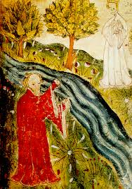
Pearl
Pearl (1380_1400) is a dream vision which carries religious significance. The narrator-father is grieving for the death of his infant daughter, Pearl. He falls asleep on her grave and dreams. His dream is an oraculum because his daughter comes to him and starts discussing Christian conceptions of the afterlife (Ibid. p. 312).
The poem is divided into twenty parts. In the first one, the narrator laments the loss of "perle wythouten spot" in a garden. Then, he goes on to describe the garden, which is one of the main features in the dream vision genre, and its flower as a paradisal place in the search of his pearl.

Slide 9
In the second part, the narrator, the speaker, falls asleep and the rest of the poem proceeds like a dream vision. Soon after the speaker falls asleep, he finds himself in the second garden; this garden is a celestial one even the graves are made of valuable pearls of the Orient. Pearl addresses the problem of earthly versus heavenly rewards through a more specific situation.
According to Kevin Marti, the speaker is a jeweler and he has lost his pearl without a price which saddens him beyond all reasons. Then, he falls asleep and the pearl appears to him as a maiden dressed in white and chastises him for thinking more of his earthly pleasure than of his eternal reward in heaven. As the jeweler is not ready to enter heaven, he is sent back to complete his journey of life and to strive for his place in the hereafter (Marti, 2002, p. 33).

Slide 10
PEARL
(prologue)
PEARL of delight that a prince doth please
DEAR of delight that a prince doth please
To grace in gold enclosed so clear,
A vow that from over orient seas
Never proved I any in price her peer.
So round, so radiant ranged by these, So fine, so smooth did her sides appear That ever in judging gems that please Her only alone I deemed as dear.
Alas! I lost her in garden near:
Through grass to the ground from me it shot;
I pine now oppressed by love-wound drear For that pearl, mine own, without a spot.

Slide 11
By that spot my hands I wrung dismayed;
For care full cold that had me caught A hopeless grief on my heart was laid.
Though reason to reconcile me sought,
For my pearl there prisoned a plaint I made, In fierce debate unmoved I fought;…
Be comforted Christ Himself me bade, But in woe my will ever strove distraught.
On the flowery plot I fell, methought;
Such odour through my senses shot,
I slipped and to sudden sleep was brought,
O'er that precious pearl without a spot.

Slide 12
ROM that spot my spirit sprang apace,
On the turf my body abode in trance;
My soul was gone by God's own grace
Adventuring where marvels chance.
I knew not where in the world was that place
Save by cloven cliffs was set my stance;
And towards a forest I turned my face, Where rocks in splendour met my glance;
From them did a glittering glory lance, None could believe the light they lent;
Never webs were woven in mortal haunts
Of half such wealth and wondermen
Thus arrayed was all in wonderment
That forest where forth my fortune led;
No man its splendour to present
With tongue could worthy words have said.
I walked ever onward well-content;
No hill was so tall that it stayed my tread;
More fair the further afield I went
Were plants, and fruits, and spices spread;
Through hedge and mead lush waters led
As in strands of gold there steeply pent.
A river I reached in cloven bed:
O Lord! the wealth of its wonderment!
(Dream Report)

Slide 13
The adornments of that wondrous deep
Were beauteous banks of beryl bright:
Swirling sweetly its waters sweep,
Ever rippling on in murmurous flight.
In the depths stood dazzling stones aheap
As a glitter through glass that glowed with light,
As streaming stars when on earth men sleep
Stare in the welkin in winter night;
For emerald, sapphire, or jewel bright Was every pebble in pool there pent, And the water was lit with rays of light, Such wealth was in its wonderment.
River (Water symbolism)

Slide 14
Debate on Grief and Death
[277] Then this visitor was a jewel to me, and jewels were her courteous statements. ‘Indeed,’ I said, ‘my blissful noble one, you completely dispel my great distress. I beg you to pardon me. I believed that my pearl was annihilated; now I have found it I shall rejoice, and live with it in bright groves, and praise my Lord and all His laws who has brought me near this bliss. If I were now beside you beyond these waters, I would be a joyful jeweller.’
[289] ‘Jeweller,’ said that pure gem, ‘why do you humans jest? You are so mad! You have spoken three statements at once: all three were, indeed, thoughtless. You do not know at all what one [of them] means; your speech escaped before you thought [lit. before your understanding]. You say you believe me [to be] in this valley because you can see me with [your] eyes; second, you say you will yourself live right here in this country with me; the third, that you will pass this noble stream – that may no joyful jeweller.

Slide 15
Debate on God’s Grace
[493] ‘There is no limit to His generosity,’ that noble maiden then said to me, ‘for everything that He ordains is truth, and He can do nothing that is not just. As Matthew relates in the true gospel in your mass, about almighty God, He conceives [it] very aptly in a parable and likens it to [the] bright [kingdom of] heaven. “My kingdom on high,” he says, “is like a lord who had a vineyard, I perceive. The beginning of the season Pearl lines [457–503] 11 had come, the time was right for working in the vineyard.

Slide 16
Debate on Salvation of the Innocence
[745] ‘O flawless pearl in pure pearls,’ I said, ‘who wear the pearl of price, who formed your fair figure for you? Whoever made your clothing was most skilful; your beauty never came from nature – Pygmalion never painted your face, nor did Aristotle through his learning speak of the nature of these special virtues; your complexion surpasses the fleur-delis; your angelic bearing [is] so completely gracious. Tell me, beautiful maiden, what kind of position does such a flawless pearl hold?’ [757] ‘My peerless Lamb,’ she said, ‘my beloved Destiny who can amend everything, chose me for His bride, although at one time such a union would have seemed unfitting. When I left your damp world He called me to His beatitude: “Come here to Me, My sweet love, for there is no stain or spot in you.” He gave me strength and also beauty; on the dais he washed my clothing in His blood, and crowned me pure in virginity, and arrayed me in flawless pearls.’ [769] ‘Why, flawless bride who shine so bright, who have such rich and plentiful royal dignities, what kind of thing can that Lamb be who would wed you as His wife? You climbed so high over all others to lead with Him so queenly a life. So many [beautiful] ladies have lived in hard struggle for Christ, and you have thrust out all those noble ones, driving away all others from that marriage, you alone [being] strong and firm enough, a peerless and flawless maiden.’

Slide 17
Epilogue:
[1189] If I had all the time submitted to that Prince’s pleasure, and yearned for no more than was allowed me, and been content with that in true resolve, as the pearl that was so fair had begged me, quite probably, drawn into God’s presence, I would have been brought to more of His mysteries. But people always want to receive more good fortune than could belong to them by right; therefore my joy was quickly shattered, and I cast out of the everlasting regions. Lord, those who strive against You are mad, or who propose anything against Your pleasure. [1201] To please the Prince or be reconciled [to Him] is very easy to the good Christian; for I have found Him, both day and night [i.e. at all times], a God, a Lord, an entirely perfect friend. On this mound this happened to me [lit. I received this chance], lying prostrate for sorrow for my pearl, which I afterwards committed to God, with my own [blessing] and the precious blessing of Christ, whom the priest shows us every day in the form of bread and wine. May He grant us all to be humble servants and precious pearls to His pleasure.

Slide 18
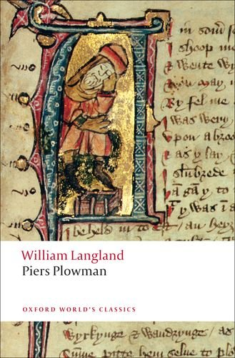
William Langland’s Piers Plowman
The Vision of William Concerning Piers the Plowman

Slide 19
Piers Plowman
It is believed to have been written in the late 14th century.
It has three versions; A text, B text, C text, which are slightly different from each other.
A remarkable example of dream vision narrative (for satirical purposes) and allegory
It is a profound satire on the social, religious, and economic structures in the mediveal English society.
It is a series of dream visions experienced by the narrator, identified as Will.
The poem's view of social hierarchy and the feudal system is not simply a representation of contemporary social norms, but rather a commentary on the constructed inequalities and moral values.

Slide 20
Cont’d..
The use of dreams was a conventional literary device, but Piers Plowman is unusual in containing not one dream sequence but eight, and two more «dreams within dreams».
«These sights I saw, and seven times more.»
The poem examines the role and duties of government, the papacy, the clergy and thedifferent social classes.
Issues such as economic relations, criminal justice, welfare, diet, food shortages, finance, taxation, trade, war and peace, heredity, medicine, the natural world, marital relations, parenting and the limits of academic learning are the focal points of the poem.

Slide 21
Allegory
An extended metaphor in which the characters, places, and objects in a narrative carry figurative meaning. (abstractions are presented as persons) In its simplest terms, it is to say one thing and mean another. Often an allegory’s meaning is religious, moral, or historical in nature.
In Piers Plowman, allegorical meaning is captured through personifications. Conscience, Fidelity, Gluttony, Pride, Seven Deadly Sins and the other human strengths and weaknesses named as characters.
«I must sit… I can’t stand, I can’t stoop, I can’t kneel with no stool.» (Sloth)
The entire poem revolves around the narrator’s quest for how to live a good Christian life that combines practical activity with spiritual reflection.

Slide 22
Mirror of the 14th Century
14th century was an epoch of great turbulence on English soil:
The Black Death killed a large percentage of the population, thus creating labour shortages that led to economic hardship.
It was also the time for the Peasants' Revolt of 1381, when the lower classes protested against the oppressive mechanisms of the feudal system.
Thus, the feudal system was a social hierarchy: king at the top, then nobles, knights, peasants which is a very rigid class system. At the core was land ownership and agricultural production, where serfs and peasants would work the land owned by the nobility and the Church.

Slide 23
Prologue : «field full of folk»
Some were pushing a plow with no time for play, And were sweating as they scattered and sowed the seed And gathered the grain that the greedy would squander; Some were pouting like popinjays, strutting with pride, Bedecked in dandified, elegant dress; And many were practicing penitence and prayer, Living soberly and strictly for the sake of our Lord In the hope that they’d have their reward in heaven, Such as anchorites, hermits who aren’t seen abroad And don’t go roistering round the roads. Or lead lives of luxury, lechery and lust.
Beggars and tramps were bustling about, Their bellies and bags crammed to bursting with bread, Telling falsehoods for food, fighting in taverns And going to bed as gorged as gluttons,
There were pilgrims and palmers pledging to go Conjointly on journeys to Rome and Saint James, Which would let them tell lies for the rest of their lives, And some were saying they’d already seen shrines And were citing wise stories they said they had heard. But the way that they spoke showed their stories were slim And their tongues were attuned not to truth but to lies.
And further, I saw all four schools of friars Preaching to people to make a fat profit, Construing the Gospel to suit themselves, Giving it meanings to go with their greed And clad in unclerical clothes that matched The money they made from their merchandise

Slide 24
Parliement of Rats (Dream Report) (Allusion to Good Parliement of 1376)
In which I fall asleep on the Malvern Hills and see in my first dream all manner of folk caught between a tower and a dungeon: beggars and burghers, priests and pilgrims, lawyers and laborers, tradesmen and tramps, knights and their king. A parliament of rats and mice meets to discuss belling the cruel cat from court, but I dare not say who the cat is.
A mouse who seemed more sensible than some Strode forth sternly and stood before them all, Berating as follows the rabble of rats: “If we killed the cat, another would come, To catch us and ours, wherever we hid. So I counsel the commons to forget the cat, And not be so bold as to bother him with bells. When he’s carving his venison or catching poor coneys He leaves us alone, and our losses are less Than the endless horrors we’d have if we crossed him; We’d be rid of a tyrant, but have turmoil and trouble. (Accept oppression or risk greater chaos by seeking change)
So let us allow him to do as he likes, To catch what he can, whether collared or free. My word to the wise is: Keep watch on your own!” These sights I saw, and seven times more. But by dear God in heaven I dare not write down What my rat dream may signify—solve that yourselves!

Slide 25
Division of the earth/body and heaven/spirit
“Go to the Gospel,” she said, “and ask God,
For when people proffered a penny in the Temple,
Wondering whether they should worship Caesar,
God asked what sort of inscription they saw
50 And whose was the image that was on the coin.
‘Caesar’s,’ they said, ‘we each can see him.’
‘Then render to Caesar,’ God said, ‘what is Caesar’s,
And to God what is God’s, if you want to do good.’2
For rightful Reason should rule you all:
55 Let the warden of your wealth be your Native Wit,
To guard and give out your gold as required,
And to keep both caution and thrift in your thoughts.”
The world is wicked and will want to betray you,
And the devil and the flesh will join forces to defeat you;
Your soul understands it and says it in your heart,
And I warn you too, to be wary and aware.”
“Thank you,” I said, “I see what you’re saying.
But tell me, Madam, the money that men
Amass on earth—who owns it, whose is it?”

Slide 26
Lady Church: As a Divine Guide
What woman she was who advised me so wisely.
“You know my name: I’m none but the Church.
I took you to me and taught you the faith,
And your godparents bound you to obey my bidding
And to love me loyally throughout your life.”
I commended myself to her mercy for my sins,
Pleading on my knees for her prayers for God’s pity,
Entreating her to teach me to turn to Christ,
And to do as my Maker might command:
“Don’t tell me of treasure but teach me simply,
Since you are saintly, how to save my soul.”
“When all treasures are tried,” she said, “Truth is the best,
For God is charity, as the Gospel agrees.
It’s as priceless a precept as God is in person.
If your tongue is true and you tell no lies,
Act by that axiom and wish no one harm,
Then the Gospel grants that you will be godly
And like our dear Lord, as Saint Luke has said.
The wise who understand should spread that wisdom,
Which is claimed in common by Christians and heathens.

Slide 27
Satire on Clergies and Church
In which the lady leaves me and I dream of the impending marriage of Miss
Money to False Fickle- tongue, surrounded by clerics, lawyers and court officials.
Theology intervenes, persuading them to seek approval for the marriage from the court at Westminster, where the King threatens to arrest the entire dishonest gang, who flee, leaving Miss Money alone. Passus II
Miss Money now means to marry a rogue
Called False Fickle- Tongue, whose father was a fiend.
It was fast- talking Flattery who persuaded folk,
And Liar who led them to allow the match.
Tomorrow’s the moment the marriage takes place,
So you can, if you care to, discover what kind
Of motley admirers consort with Money.
Inspect them for sure, but stay well clear
And keep disapproval and reproaches private
Till Fidelity’s empowered to punish and reprove them.
I commend you to Christ and his immaculate mother.
Don’t covet Miss Money lest your conscience accuse you
“The mischievous minx,” Lady Church said, “called Money,
Who disdains Fidelity, my dearest love,
And lies about him to the lords of the law.
She is privileged like me in the palace of the Pope,
Though she’s base and a bastard and Truth tries to ban her.
For her father was false and a fickle talker,
Who has told no truth since the time he was born,
And Miss Money has inherited his morals and manners:
Like father, like son. Every good tree bringeth forth good fruit, and
the evil tree bringeth forth evil fruit.

Slide 28
Piers Plowman: As a Spiritual Guide for Repentance
This time I saw more scenes than I’ve told:
The field full of folk the same as before,
But with Reason preparing to preach to the people. Clutching a cross, he stood by the King To explain the Plague as the penalty for sin,
And the southwest wind on Saturday since
…I could easily dilate on this lesson at length
But shall solely say what I saw, God save me!
But Piers the Plowman pressed them to do good: “There’s a maiden called Mercy who may let you in,For she and her son are cousins to sinners
Then Sloth came, beslobbered with his slimy two eyes.
“I must sit,” he said, “or I’ll fall fast asleep;
I can’t stand, I can’t stoop, I can’t kneel with no stool.
If I’m tucked up in bed, unless bothered by my bowels,
390 No ringing will rouse me till I’m ready to dine.”
He babbled “Benedicite,” belched, beat his breast,
And stretched and yawned and started to snore.
“Wake up,” snapped Repentance, “and pray for a pardon.”

Slide 29
Satire on Exploation of Unpriviliged groups: Passus V-VI
In which I awake briefly before seeing my second dream, of Reason preaching to
the people about honest work. The Seven Deadly Sins confess their idle selfishness and gross behavior among friars, merchants, money- lenders and drunkards.
Repentance persuades them and the people to repent and seek out Truth, and a
plowman called Piers gives them directions. A few rogues think these too onerous.

Slide 30
Better treatment and humility
The knight was complaisant, replying to Piers:
“By my power I pledge and make you a promise
To keep to our contract, through combat if needful;
As long as I live I shall loyally guard you.”
“There’s one more point,” said Piers, “if you please.
You should treat your tenants as Truth would wish
And should make your fines both merciful and fair:
Let humility have mastery, not the money.
And if poor men proffer you presents and gifts,
You may not merit them so you must not take them.
They may be returnable in twelve months’ time
In perilous Purgatory, that place of pain.
And you’d better not abuse your bonded workers;
They may be your underlings on earth, but in heaven
They may be above you in merit and bliss:
Friend, go up higher.

Slide 31
Piers’ wife was a woman called Work- while-you-may,
His daughter was Do- right-or-do-get-a-beating,
80 And his son was Suffer- your-seniors-to-be-right-
Without-grumbling-or-groaning-or-you-may-regret-it-
Let-God-have-his-way-as-his-word-says-as-well.
“Now I’ll go with these people,” said Piers, “as a pilgrim,
But before I set forth I shall frame a will
For I’m old and gray and have goods I must give you.
I make these commands in the Lord’s name, amen:
My soul I present to him who deserves it,
To defend from the devil as I doubt not he’ll do
Till my reckoning is come, as the Creed declares,
90 When my lot, I believe, shall be mercy and love.
And the Church shall keep my carcass in care
For it took a tithe of my corn and my takings,
And I paid up promptly for the peril of my soul,

